Slide 1
SPI Protocol
SPI stands for the Serial Peripheral Interface. It is a serial communication protocol that is used to connect low-speed devices. It was developed by Motorola in the mid-1980 for inter-chip communication. It is commonly used for communication with flash memory, sensors, real-time clock (RTC), analog-to-digital converters, and more. It is a full-duplex synchronous serial communication, which means that data can be simultaneously transmitted from both directions.
The main advantage of the SPI is to transfer the data without any interruption. Many bits can be sent or received at a time in this protocol.
In this protocol, devices are communicated in the master-slave relationship. The master device controls the slave device, and the slave device takes the instruction from the master device. The simplest configuration of the Serial Peripheral Interface (SPI) is a combination of a single slave and a single master. But, one master device can control multiple slave devices.

Slide 2
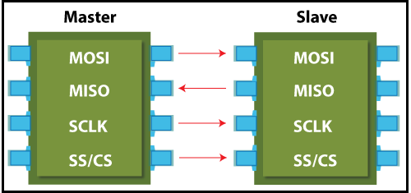
SPI Interface
The SPI protocol uses the four wires for the communication. There are shown in the figure.
MOSI: MOSI stands for Master Output Slave Input. It is used to send data from the master to the slave.
MISO: MISO stands for Master Input Slave Output. It is used to send data from the slave to the master.
SCK or SCLK (Serial Clock): It is used to the clock signal.
SS/CS (Slave Select / Chip Select): It is used by the master to send data by selecting a slave.
Note: If the single slave is present in the communication, that required only three wires. The SS (slave select) is not required in it

Slide 3
Advantages of SPI
The main advantage of the SPI is to transfer the data without any interruption.
It is simple hardware.
It provides full-duplex communication.
There is no need for a unique address of the slave in this protocol.
This protocol does not require precise oscillation of slave devices because it uses the master's clock.
In this, software implementation is very simple.
It provides high transfer speed.
Signals are unidirectional.
It has separate lines of MISO and MOSI, so the data can be sent and received at the same time.

Slide 4
Disadvantages of SPI
Usually, it supports only one master.
It does not check the error like the UART.
It uses more pins than the other protocol.
It can be used only from a short distance.
It does not give any acknowledgment that the data is received or not.

Slide 5
Applications of SPI
Memory: SD Card, MMC, EEPROM, and Flash.
Sensors: Temperature and Pressure.
Control Devices: ADC, DAC, digital POTS, and Audio Codec.
Others: Camera Lens Mount, Touchscreen, LCD, RTC, video game controller, etc.

Slide 6
Difference between the I2C and SPI protocol.
I2C | SPI
I2C stands for the Inter-integrated controller. | SPI stands for the Serial Peripheral Interface.
It was developed by Philips semiconductor in 1980. | It was developed by Motorola in the mid-1980.
It is a half-duplex protocol. | It is a full-duplex protocol.
It supports the multiple master configuration. | It does not support the multiple master configuration.
More overhead. | Less overhead.
I2C protocol uses two cables for communication (SCL and SDA). | SPI protocol uses four cables for communication (MISO, MOSI, CS, and CLK).
Its data transfer speed ranges from 100kHz to 400kHz. | Its data transfer speed up to 25 MHz.
It is a multi-master protocol. | It is a single master protocol.

Slide 7
Real-Time operating system
A real-time operating system (RTOS) is a special-purpose operating system used in computers that has strict time constraints for any job to be performed.
It is employed mostly in those systems in which the results of the computations are used to influence a process while it is executing.
Whenever an event external to the computer occurs, it is communicated to the computer with the help of some sensor used to monitor the event.
The sensor produces the signal that is interpreted by the operating system as an interrupt. On receiving an interrupt, the operating system invokes a specific process or a set of processes to serve the interrupt.

Slide 8
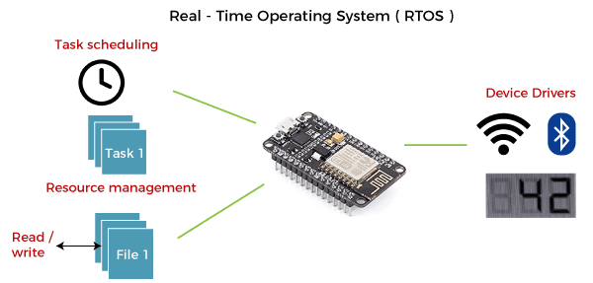
This process is completely uninterrupted unless a higher priority interrupt occurs during its execution. Therefore, there must be a strict hierarchy of priority among the interrupts. The interrupt with the highest priority must be allowed to initiate the process , while lower priority interrupts should be kept in a buffer that will be handled later. Interrupt management is important in such an operating system.
Real-time operating systems employ special-purpose operating systems because conventional operating systems do not provide such performance.

Slide 9
The various examples of Real-time operating systems are:
MTS
Lynx
QNX
VxWorks
free Rtos
etc

Slide 10
Applications of Real-time operating system (RTOS):
RTOS is used in real-time applications that must work within specific deadlines. Following are the common areas of applications of Real-time operating systems are given below.
Real-time running structures are used inside the Radar gadget.
Real-time running structures are utilized in Missile guidance.
Real-time running structures are utilized in on line inventory trading.
Real-time running structures are used inside the cell phone switching gadget.
Real-time running structures are utilized by Air site visitors to manipulate structures.
Real-time running structures are used in Medical Imaging Systems.
Real-time running structures are used inside the Fuel injection gadget.
Real-time running structures are used inside the Traffic manipulate gadget.
Real-time running structures are utilized in Autopilot travel simulators.

Slide 11
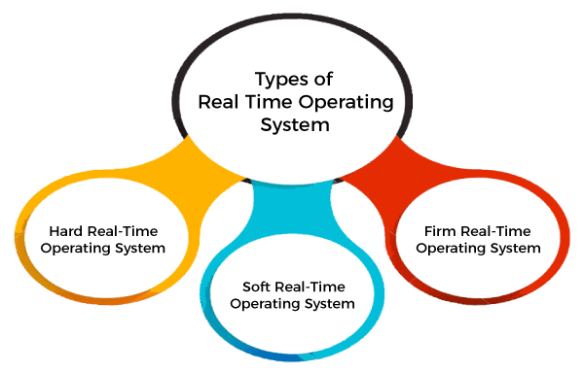
Types of Real-time operating system

Slide 12
Hard Real-Time operating system:
In Hard RTOS, all critical tasks must be completed within the specified time duration, i.e., within the given deadline. Not meeting the deadline would result in critical failures such as damage to equipment or even loss of human life.
For Example,
Let's take an example of airbags provided by carmakers along with a handle in the driver's seat. When the driver applies brakes at a particular instance, the airbags grow and prevent the driver's head from hitting the handle. Had there been some delay even of milliseconds, then it would have resulted in an accident.
Similarly, consider an on-stock trading software. If someone wants to sell a particular share, the system must ensure that command is performed within a given critical time. Otherwise, if the market falls abruptly, it may cause a huge loss to the trader.

Slide 13
Soft Real-Time operating system:
Soft RTOS accepts a few delays via the means of the Operating system. In this kind of RTOS, there may be a closing date assigned for a particular job, but a delay for a small amount of time is acceptable. So, cut off dates are treated softly via means of this kind of RTOS.
For Example,
This type of system is used in Online Transaction systems and Livestock price quotation Systems.

Slide 14
Firm Real-Time operating system:
In Firm RTOS additionally want to observe the deadlines. However, lacking a closing date might not have a massive effect, however may want to purposely undesired effects, like a massive discount within the fine of a product.
For Example, this system is used in various forms of Multimedia applications.
Advantages of Real-time operating system:
The benefits of real-time operating system are as follows-:
Easy to layout, develop and execute real-time applications under the real-time operating system.
The real-time working structures are extra compact, so those structures require much less memory space.
In a Real-time operating system, the maximum utilization of devices and systems.
Focus on running applications and less importance to applications that are in the queue.
Since the size of programs is small, RTOS can also be embedded systems like in transport and others.
These types of systems are error-free.
Memory allocation is best managed in these types of systems.

Slide 15
Disadvantages of Real-time operating system:
The disadvantages of real-time operating systems are as follows-
Real-time operating systems have complicated layout principles and are very costly to develop.
Real-time operating systems are very complex and can consume critical CPU cycles.

